Slide 1
Otago Home-Exercise
Sessions State Machine Design

Slide 2
52-Week Otago Program
Weekly counting and scheduling
  Week 1: baseline assessment and individualized exercise prescription
  Weeks 1–8: intensive start-up phase with approximately four home visits, typically every other week
  Weeks 9–52: continued home exercise with monthly phone follow-ups when no home visit occurs
  Months 6, 9, and 12: PT home visits for reassessment and prescription progression
Home Exercise throughout Weeks 1–52
  Warm-up: required before any strength or balance block.
  Strength: three days per week, with at least one non-strength rest day between strength days.
  Balance: at least three days per week; it may be performed daily when prescribed.
Additional Activities
  Walking Plan：Up to 30 minutes at the usual pace, at least twice per week
  Stair Walking：Close supervision and handrail support

Slide 3
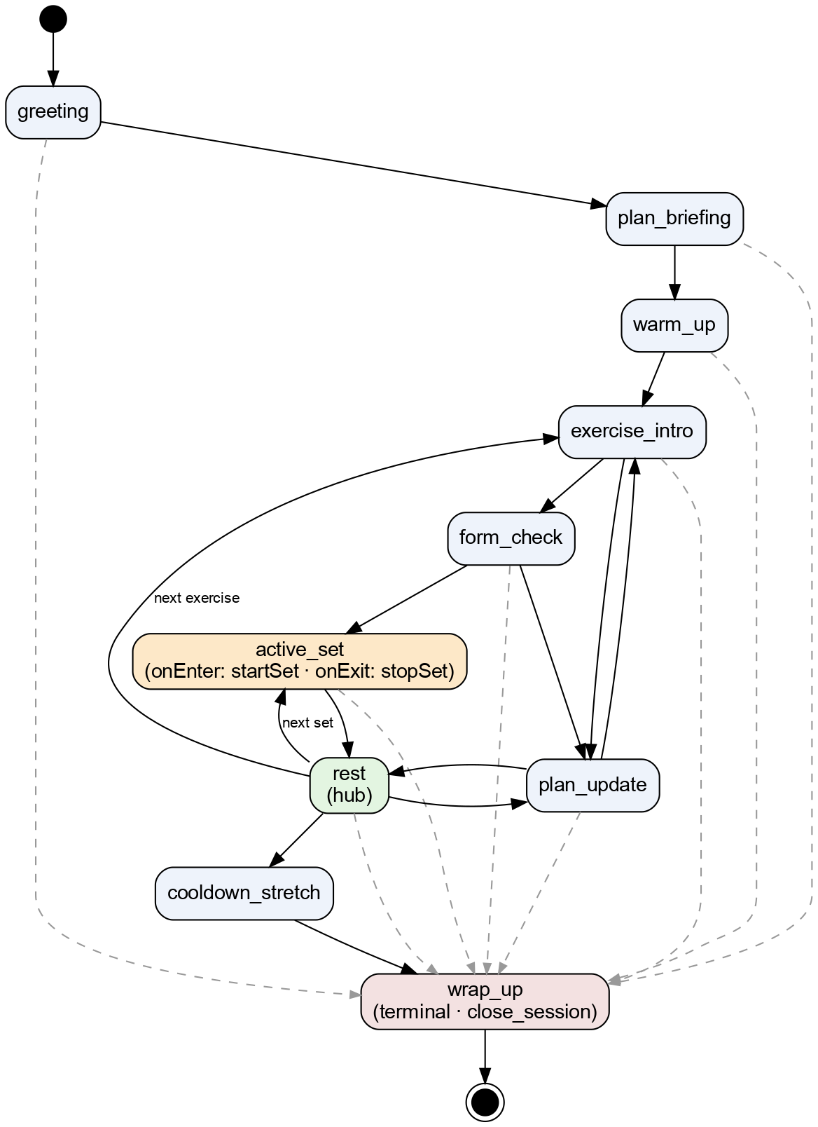
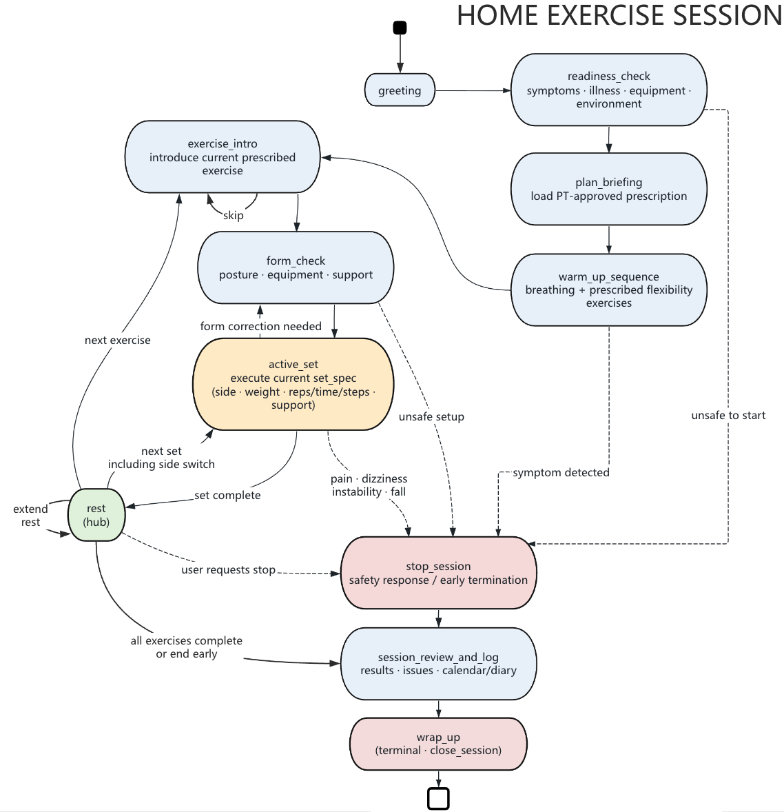

Slide 4
Updates
(+) readiness_check
(+) skip exercise
(+) form-correction
(-) plan_update
(+) safe routes to stop_session
(+) session_review_and_log
(-) cooldown_stretch

Slide 5
Motion Sequences – Warm Up
three breathing cycles
-> head movements
-> neck movements
-> trunk movements
-> ankle movements
-> back extension

Slide 6
Motion Sequences – Strength
front knee strengthening
→ side hip strengthening
→ back knee strengthening
→ calf raises
→ toe raises

Slide 7
Motion Sequences – Balance
knee bends
→ backward walking
→ walking and turning in a figure-eight
→ sideways walking
→ heel-to-toe standing
→ heel-to-toe walking
→ one-leg standing
→ heel walking
→ toe walking
→ heel-to-toe walking backward
→ sit-to-stand
→ stair walking

Slide 8
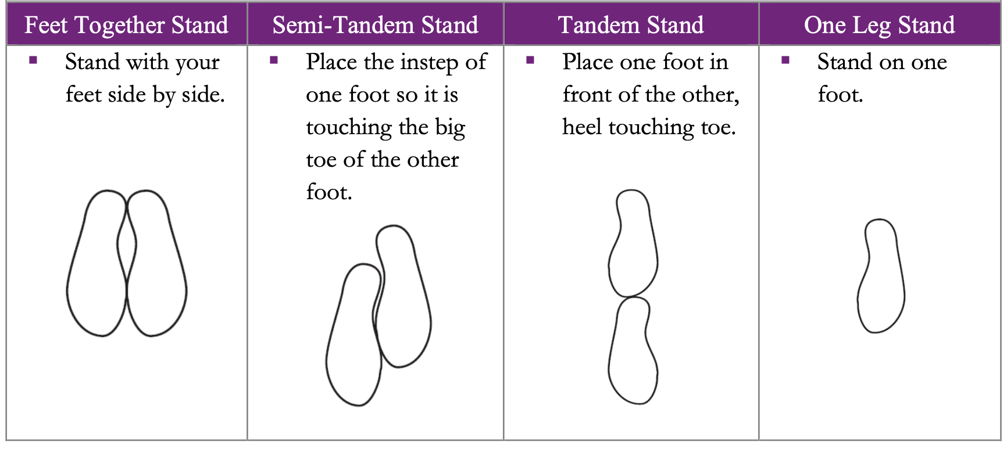
Motion-Detection Challenges
1. Hands/Foot Support Level
  2H = two-hand support
  1H = one-hand support
  NS = no support
  One-leg stand
2. Reliable heel and toe landmarks
  Heel/toe stand and heel/toe walking
  Forwards and backwards
  Toe raises
3. Foot Trajectory
  Figure-eight trajectory
  Tandem steps
4. Behavior Detection
  controlled recovery / a near fall
  unexpected hand / foot support
  Unobservable safety signals

